Slide 1
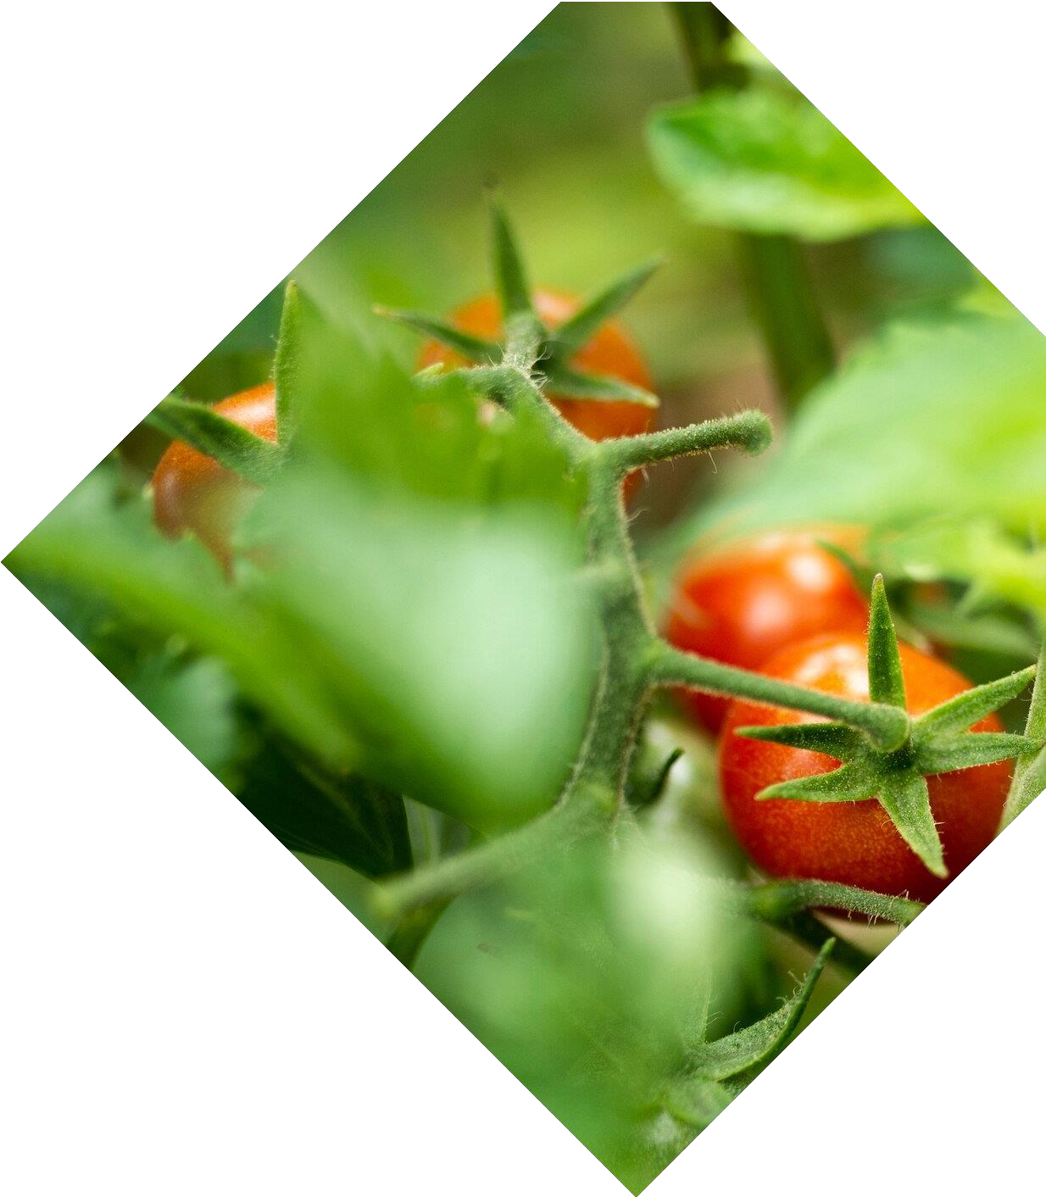

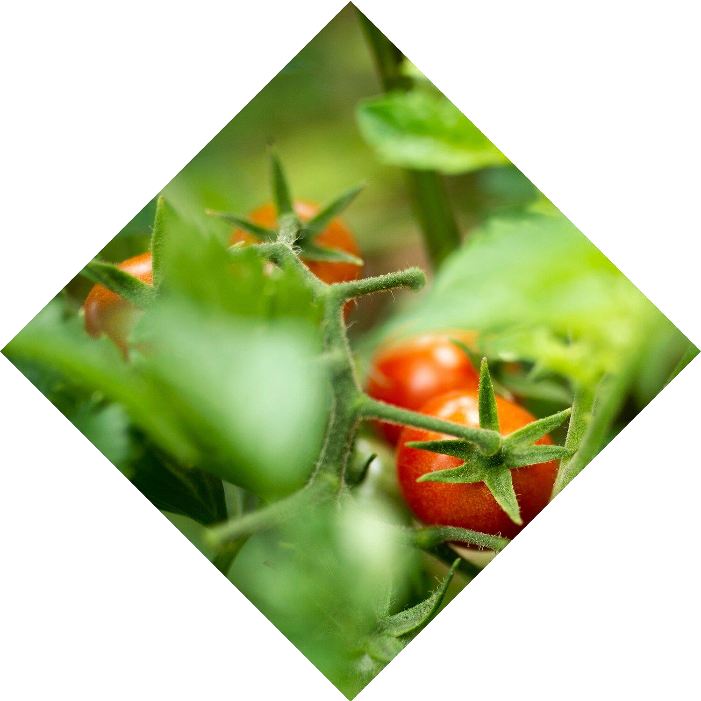
Presentation for B.Tech Project, Sem VII, 2023-24
Plant Disease Monitoring System using Computer Vision
Students Name
Guide:
Dr. Dipti Y.. Sakhare
Anushka Tiwari (213)
Lokesh Wankhede (227)
Amol More (307)
Yashashri Gawande(333)

Slide 2
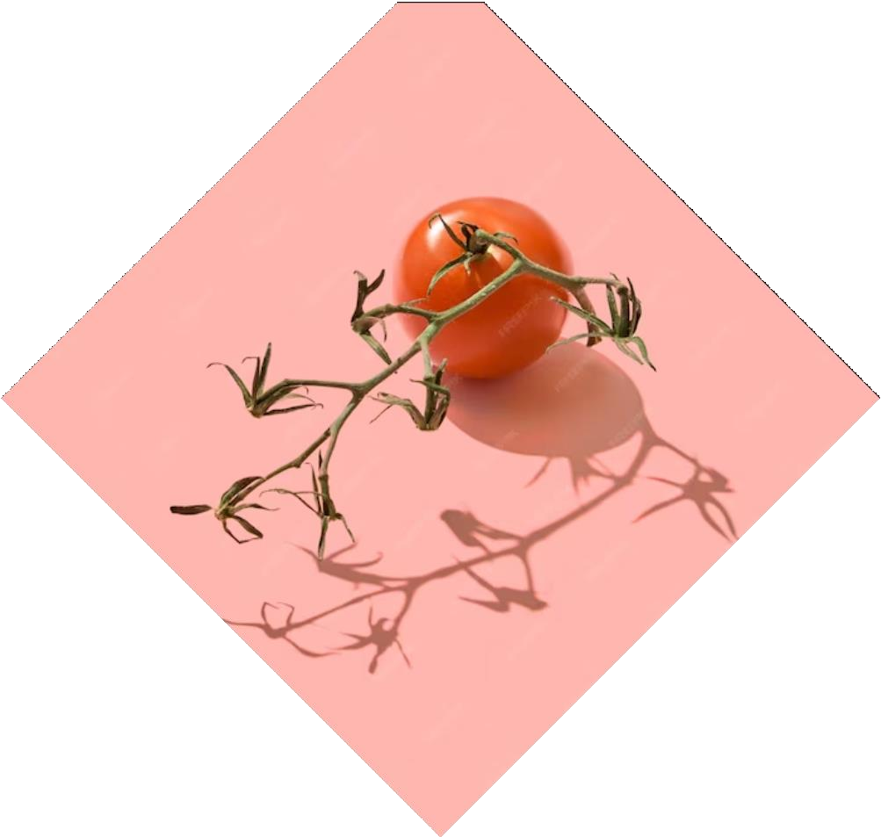
Contents
Problem Statement
Introduction
Block Diagram
Prediction Model
About GUI
Website Workflow
GUI Model
Research Study
Future Development
Conclusion

Slide 3
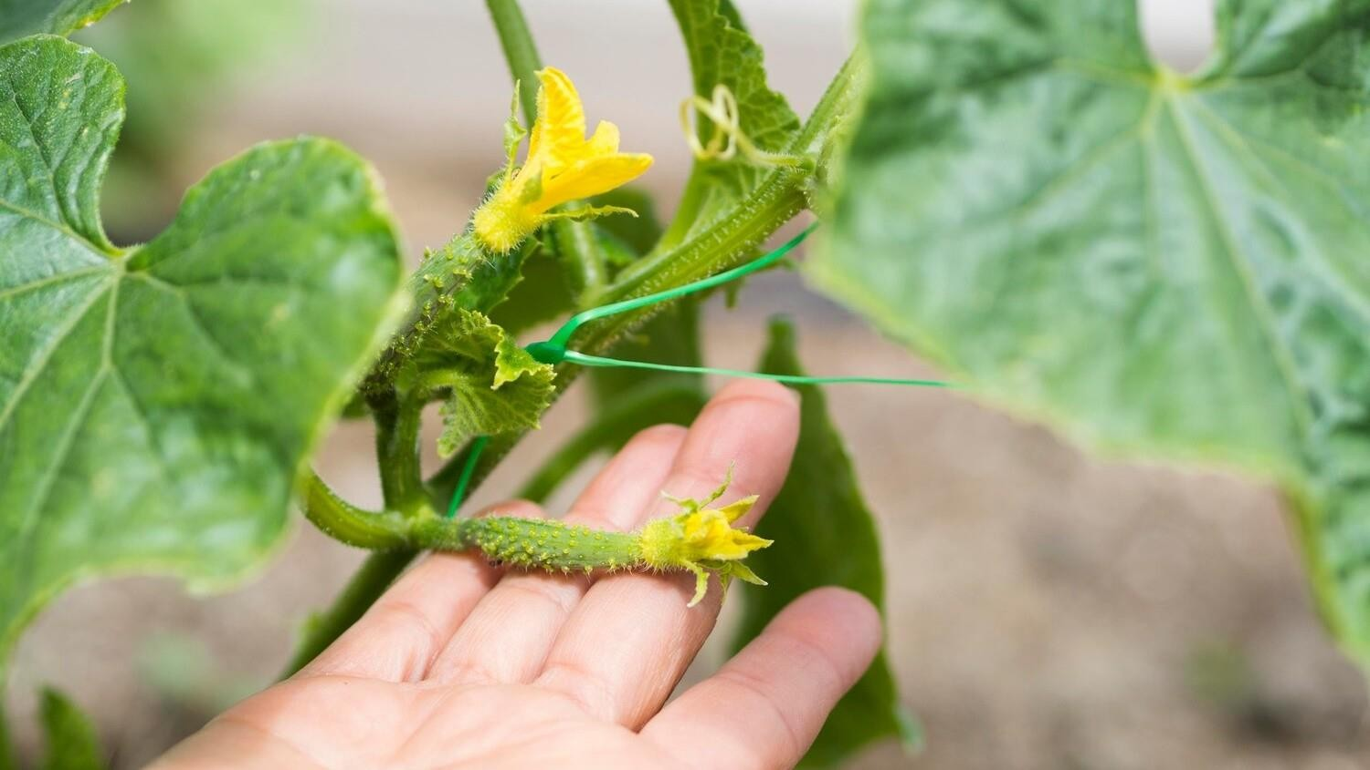
Problem Statement
Design and development of an web model for “Plant disease monitoring system using computer vision” for farmers to detect plant disease easily in their crop field.

Slide 4

Introduction
Cutting-edge technology for plant disease identification.
Utilizes image recognition and deep learning algorithms.
Offers fast and accurate diagnosis.
Supports plant health maintenance and damage prevention.

Slide 5
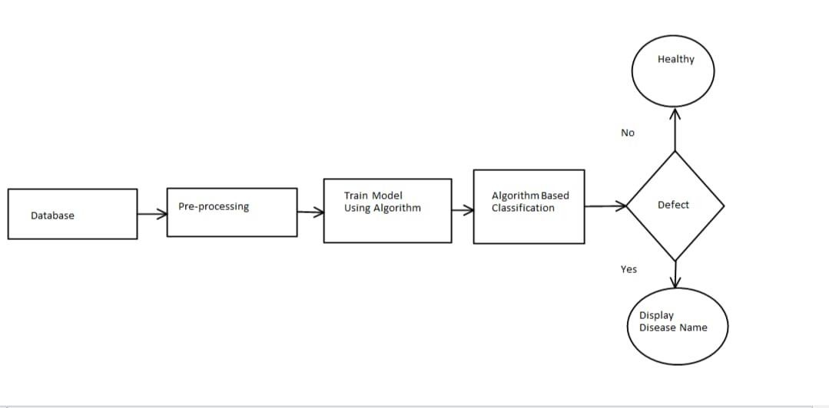
Block Diagram

Slide 6
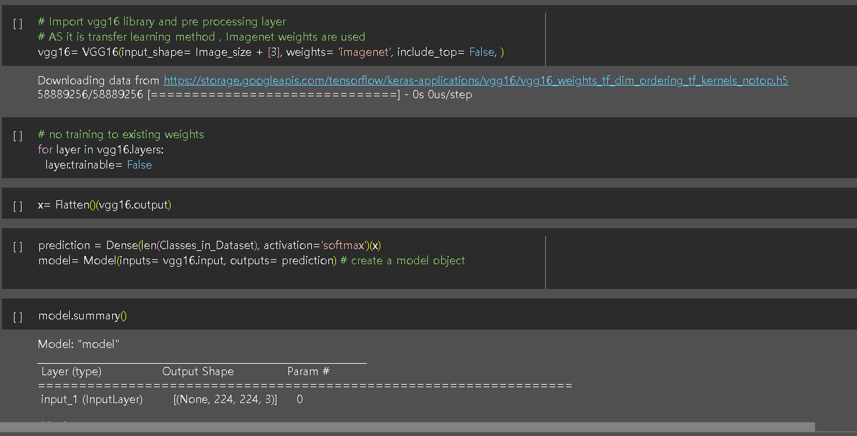
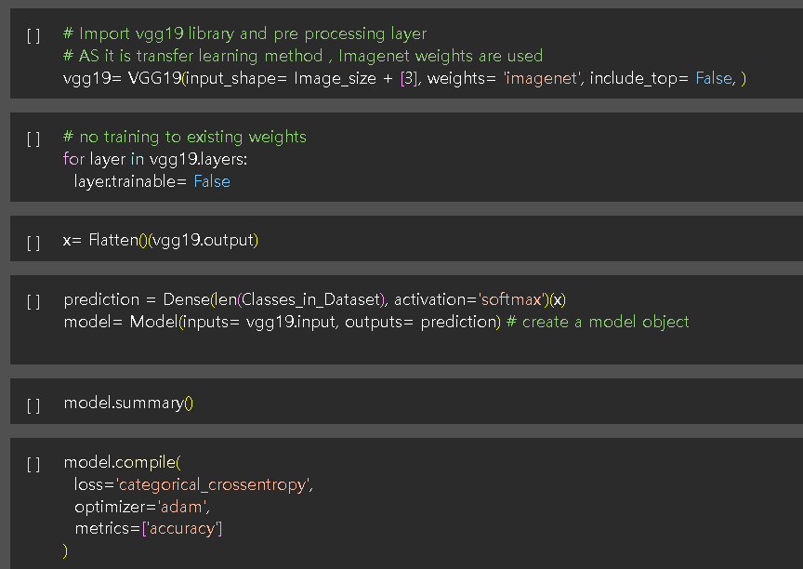
Prediction Model
VGG16 : Accuracy - 96.04
VGG19 : Accuracy - 94.56

Slide 7
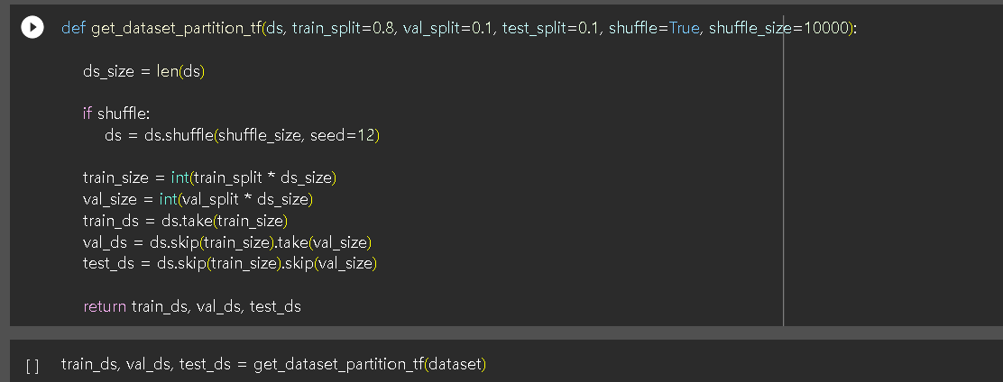
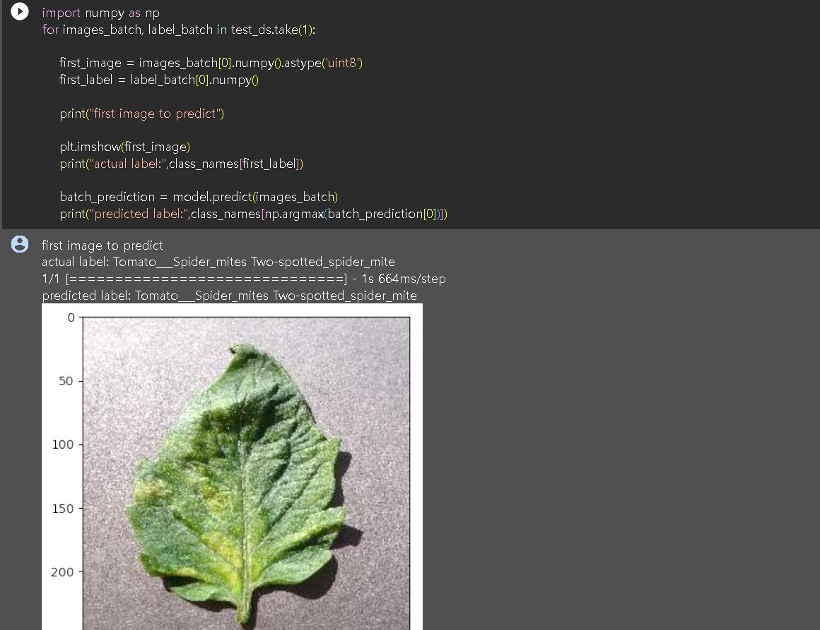
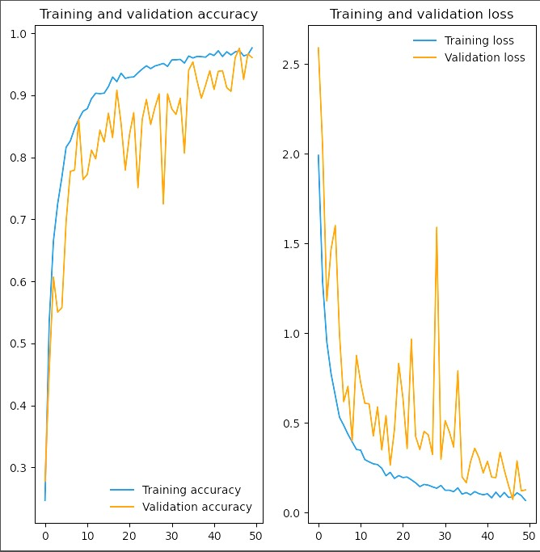
Prediction Model
DenseNet121: Accuracy - 95.26

Slide 8
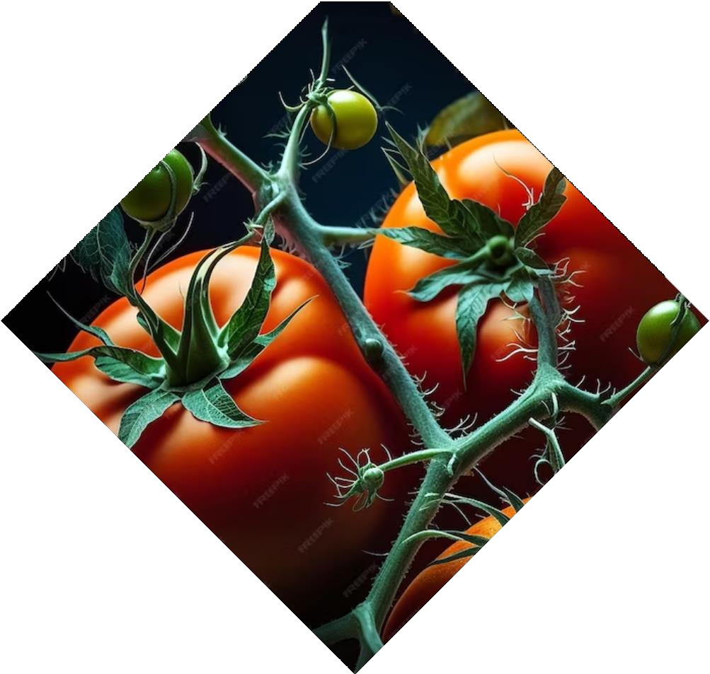
About GUI
Utilizes cutting-edge CNN (Convolutional Neural Network) algorithms
Predicts the presence of diseases in tomato plants
Simply upload a photo of your tomato plant
DL-Powered system provides an instant disease diagnosis.

Slide 9
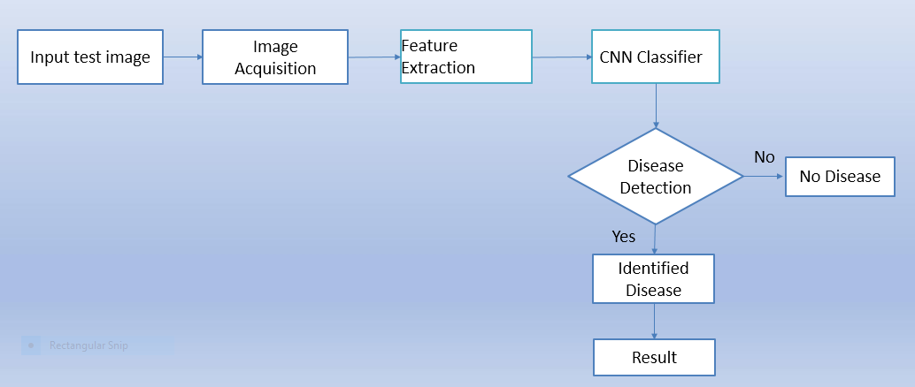
Website Workflow

Slide 10
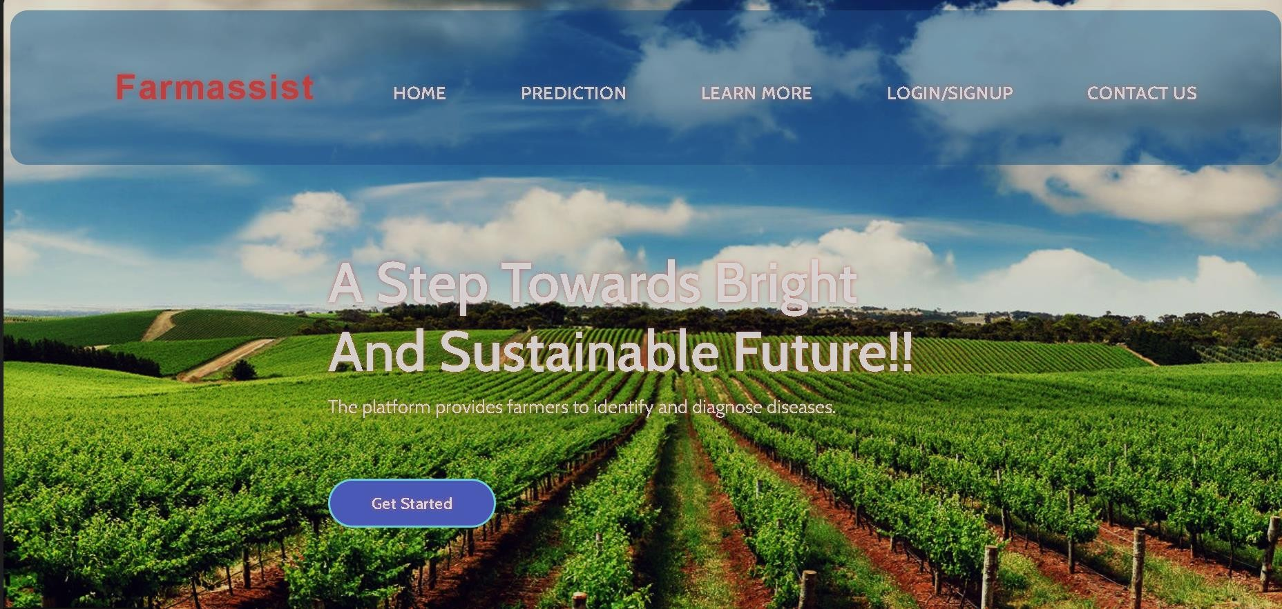
GUI Model
http://major-project-03-11-2023.s3-website.ap-south-1.amazonaws.com/prediction.html

Slide 11
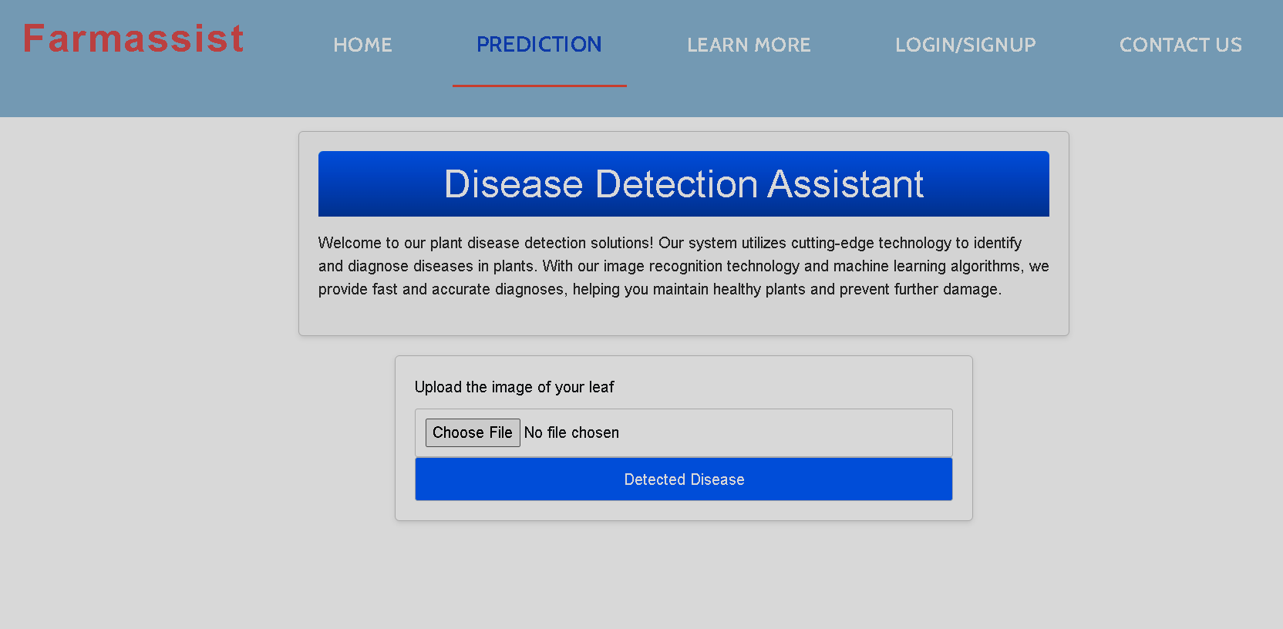
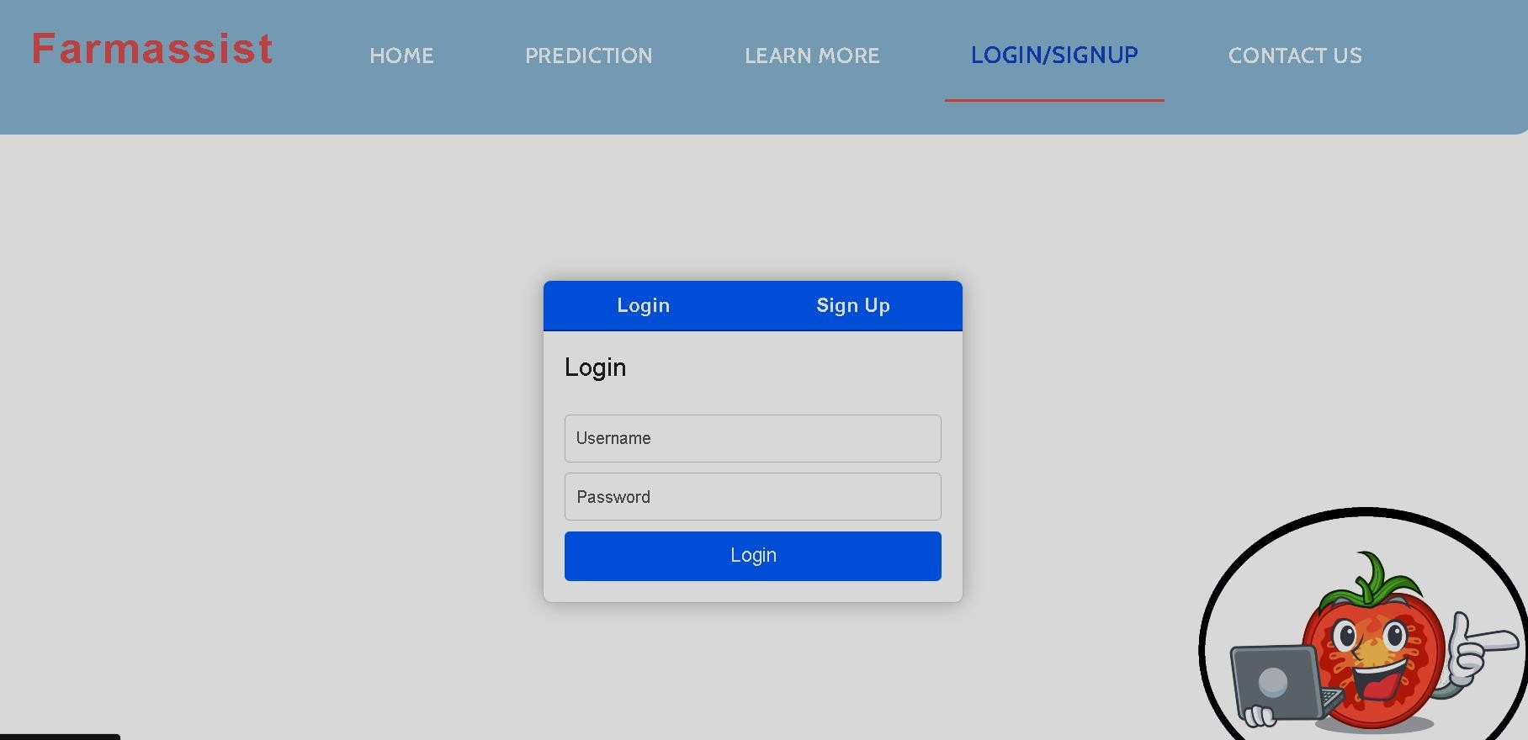
GUI Model

Slide 12
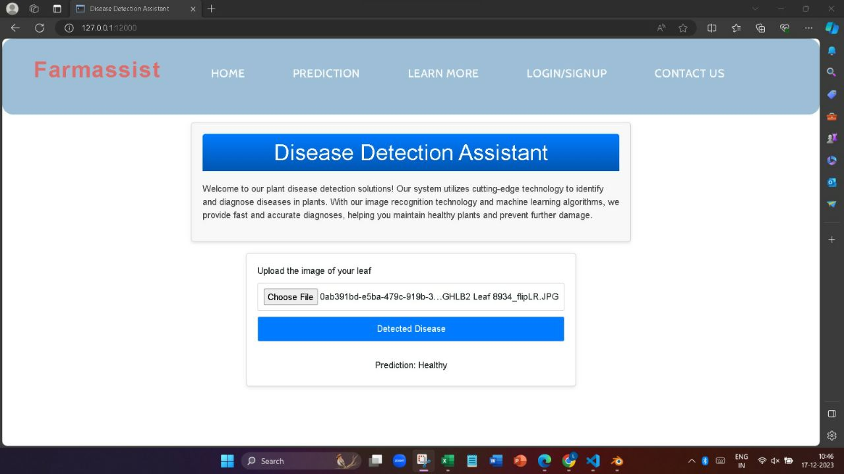
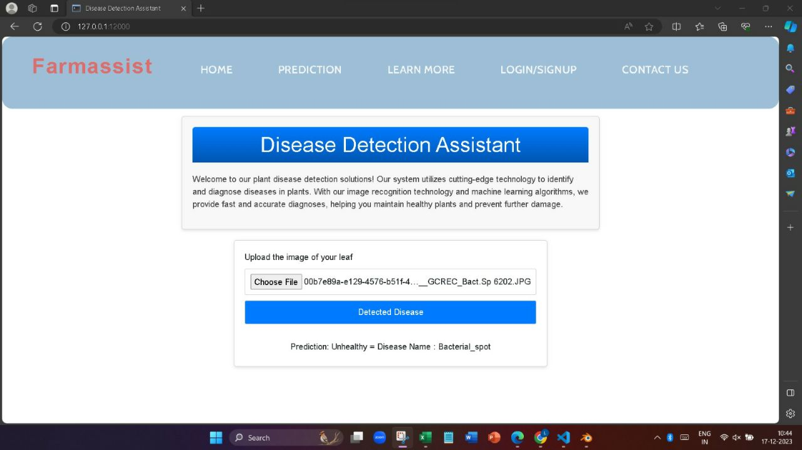
Prediction Results
Heathy Leaf
Unheathy Leaf
http://major-project-03-11-2023.s3-website.ap-south-1.amazonaws.com/prediction.html

Slide 13
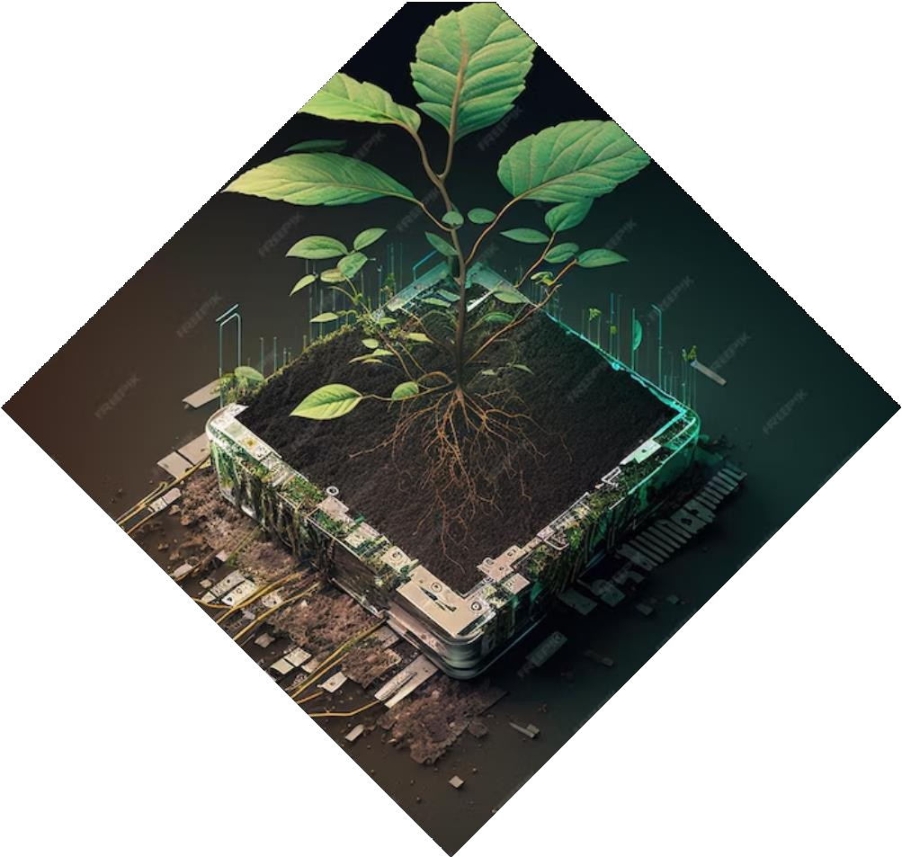
Future
Development
Commitment to continuous improvement and future developments of FarmAssist.
Roadmap includes expanding the system to monitor other crop diseases.
Integration with smart farming technologies.
Collaboration with agricultural experts worldwide.

Slide 14
Conclusion
The FarmAssist is a creative solution that addresses the challenges of tomato leaf disease monitoring.
By harnessing the power of technology and data analysis, we can empower farmers and gardeners to protect their tomato plants and optimize crop yields.
Together, let's embrace innovation and cultivate a healthier future!

Slide 15
T hanks You! Any Questions.

